Slide 1
Microsoft Visual C#: An Introduction to Object-Oriented Programming
7th Edition
Chapter 4
Making Decisions
© 2018 Cengage. All Rights Reserved. May not be copied, scanned, or duplicated, in whole or in part, except for use as permitted in a license distributed with a certain product or service or otherwise on a password-protected website for classroom use.

Slide 2
Objectives (1 of 2)
4.1 Understand logic-planning tools and decision making
4.2 Make decisions using if statements
4.3 Make decisions using if-else statements
4.4 Use compound expressions in if statements
4.5 Make decisions using switch statements
© 2018 Cengage. May not be copied, scanned, or duplicated, in whole or in part, except for use as permitted in a license distributed with a certain product or service or otherwise on a password-protected website for classroom use.

Slide 3
Objectives (2 of 2)
4.6 Use the conditional operator
4.7 Use the NOT operator
4.8 Avoid common errors when making decisions
4.9 Appreciate decision-making issues in GUI programs
© 2018 Cengage. May not be copied, scanned, or duplicated, in whole or in part, except for use as permitted in a license distributed with a certain product or service or otherwise on a password-protected website for classroom use.

Slide 4
Understanding Logic-Planning Tools and Decision Making (1 of 4)
Pseudocode
A tool that helps programmers plan a program’s logic by writing plain English statements
Flowchart
You write the steps in diagram form as a series of shapes connected by arrows or flowlines
Sequence structure
One step follows another unconditionally and sequentially
Sometimes, logical steps do not follow in an unconditional sequence
© 2018 Cengage. May not be copied, scanned, or duplicated, in whole or in part, except for use as permitted in a license distributed with a certain product or service or otherwise on a password-protected website for classroom use.

Slide 5
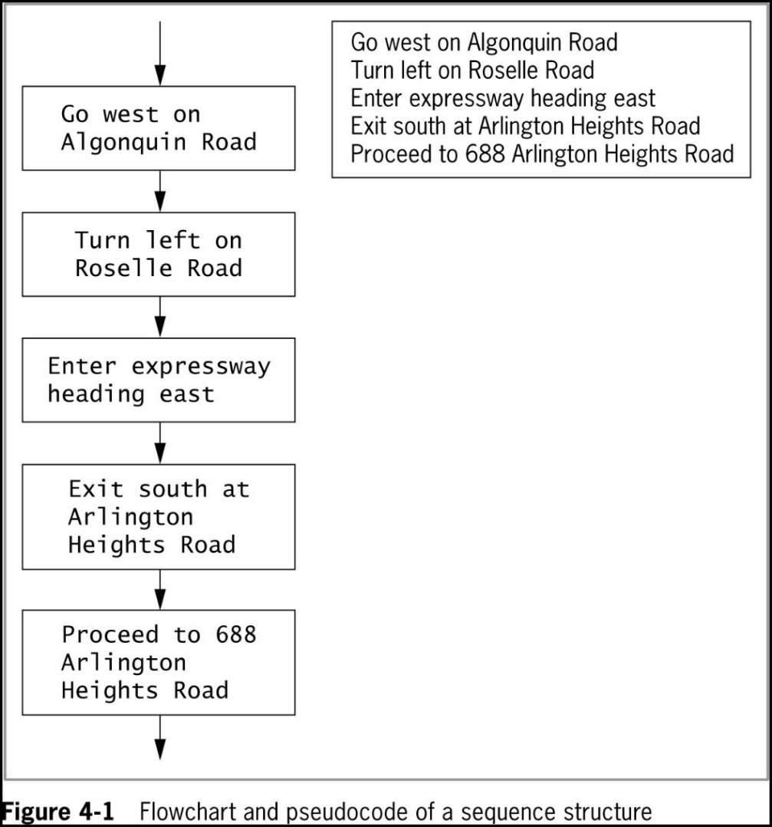
Understanding Logic-Planning Tools and Decision Making (2 of 4)
© 2018 Cengage. May not be copied, scanned, or duplicated, in whole or in part, except for use as permitted in a license distributed with a certain product or service or otherwise on a password-protected website for classroom use.

Slide 6
Understanding Logic-Planning Tools and Decision Making (3 of 4)
Decision structure
Involves choosing between alternative courses of action based on some value within a program
All computer decisions are true-or-false decisions when reduced to their most basic form
© 2018 Cengage. May not be copied, scanned, or duplicated, in whole or in part, except for use as permitted in a license distributed with a certain product or service or otherwise on a password-protected website for classroom use.

Slide 7
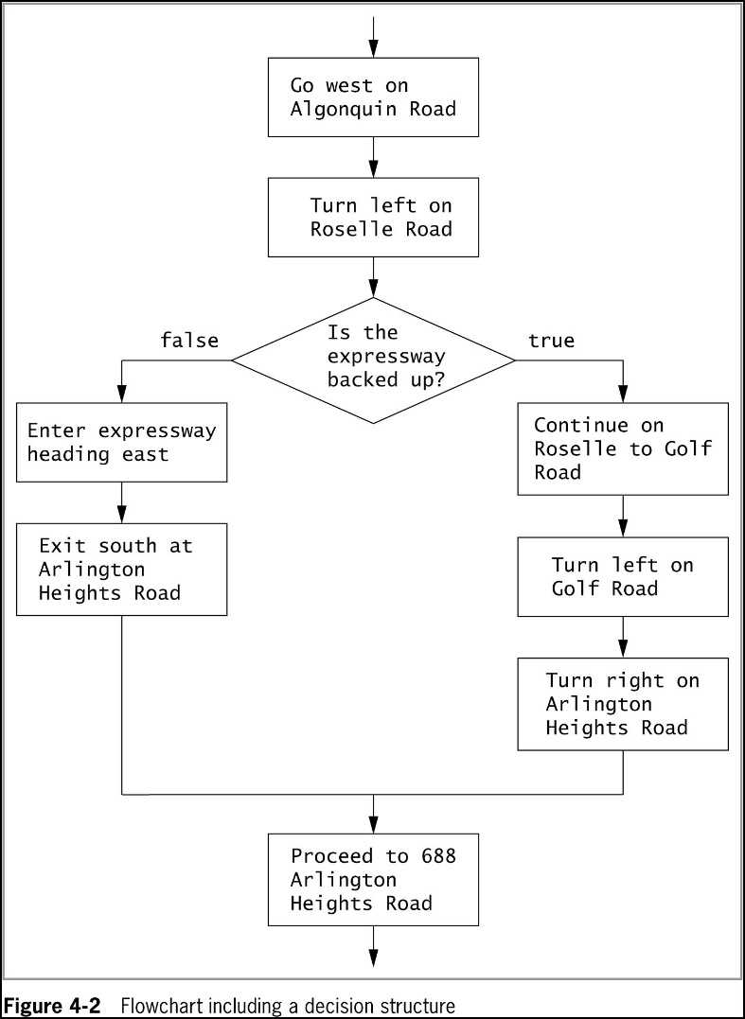
Understanding Logic-Planning Tools and Decision Making (4 of 4)
© 2018 Cengage. May not be copied, scanned, or duplicated, in whole or in part, except for use as permitted in a license distributed with a certain product or service or otherwise on a password-protected website for classroom use.

Slide 8
Making Decisions Using the if Statement (1 of 8)
if statement
Used to make a single-alternative decision
Used to determine whether an action will occur
The if statement takes the following form:
If (testedExpression)
statement;
Block
One or more statements contained within a pair of curly braces { }
The if expression that precedes the block is the control statement for the decision structure
For multiple statements to depend on an if, they must be blocked with braces
© 2018 Cengage. May not be copied, scanned, or duplicated, in whole or in part, except for use as permitted in a license distributed with a certain product or service or otherwise on a password-protected website for classroom use.

Slide 9
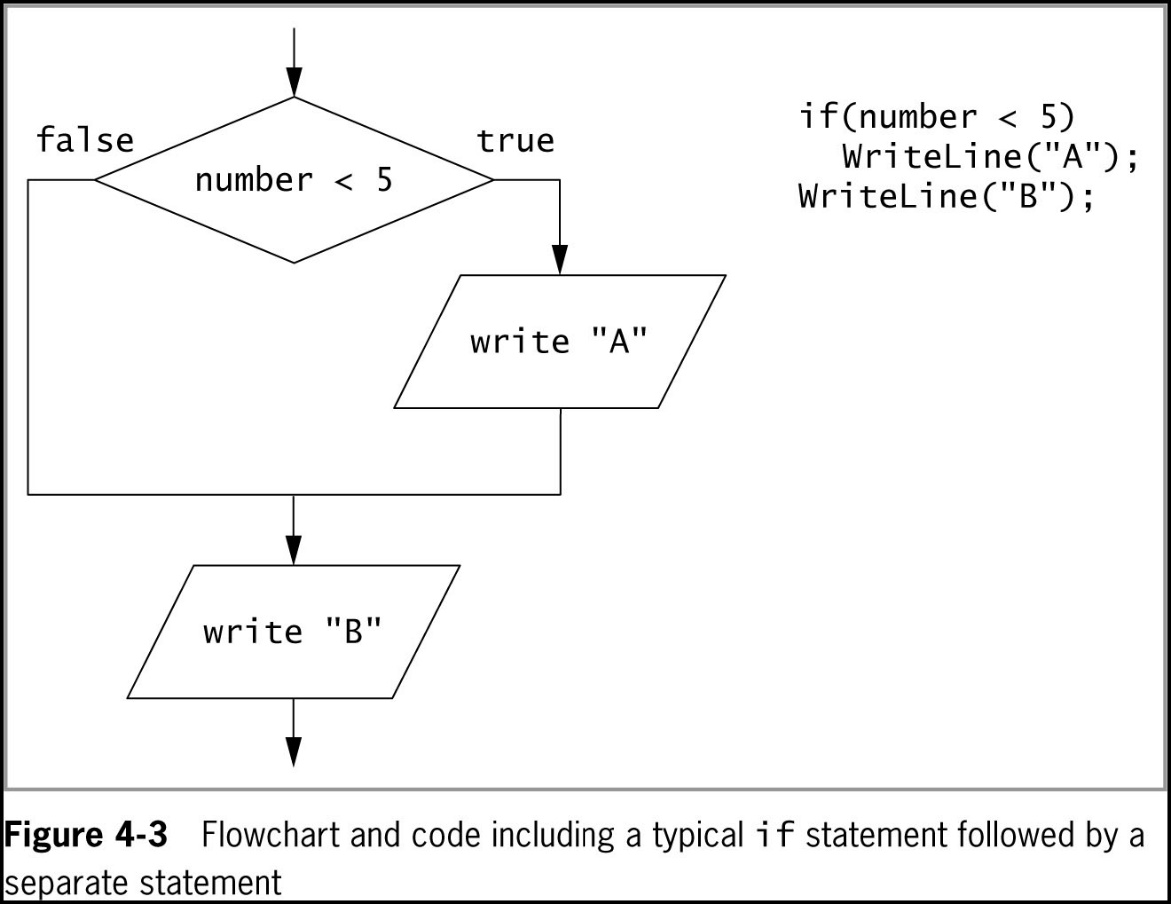
Making Decisions Using the if Statement (2 of 8)
© 2018 Cengage. May not be copied, scanned, or duplicated, in whole or in part, except for use as permitted in a license distributed with a certain product or service or otherwise on a password-protected website for classroom use.

Slide 10
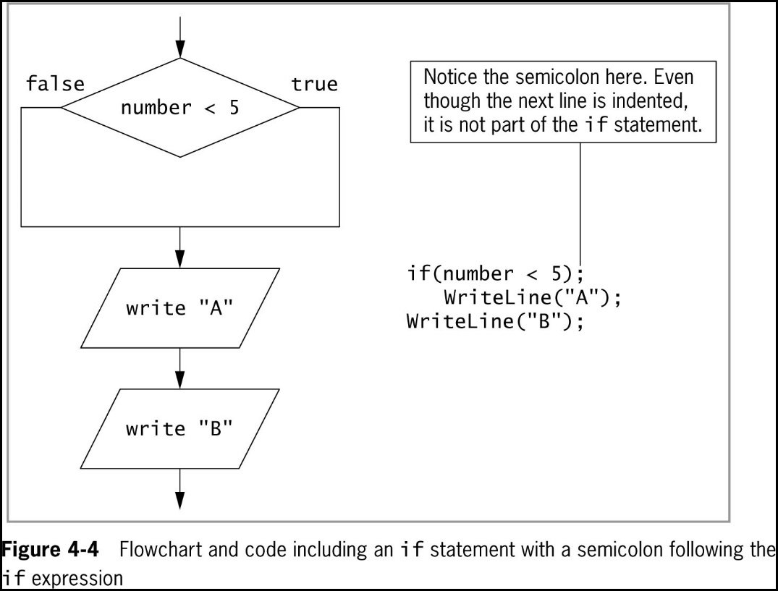
Making Decisions Using the if Statement (3 of 8)
© 2018 Cengage. May not be copied, scanned, or duplicated, in whole or in part, except for use as permitted in a license distributed with a certain product or service or otherwise on a password-protected website for classroom use.

Slide 11
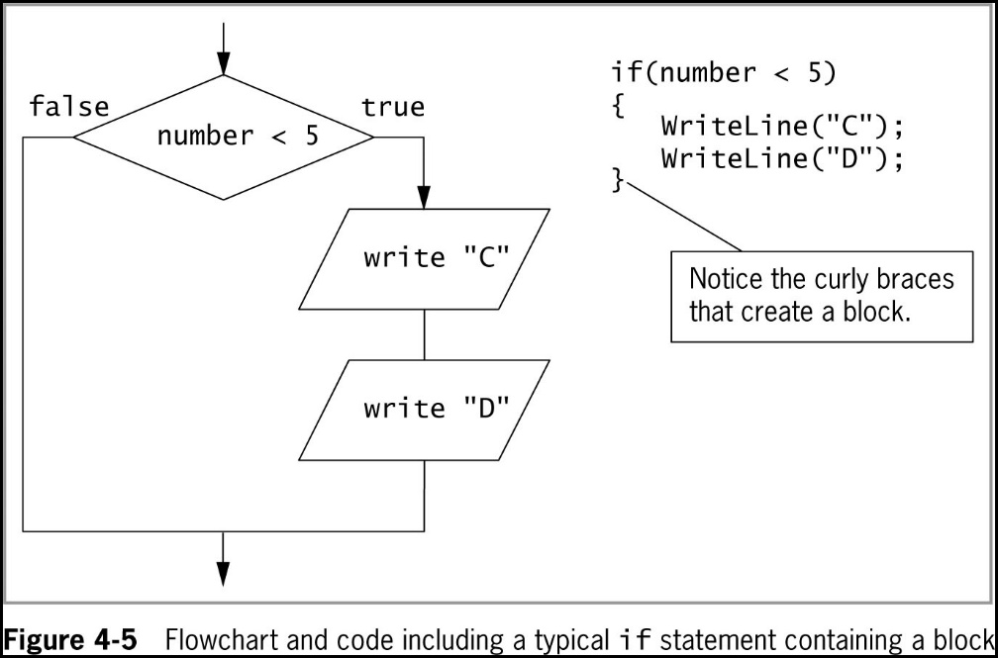
Making Decisions Using the if Statement (4 of 8)
© 2018 Cengage. May not be copied, scanned, or duplicated, in whole or in part, except for use as permitted in a license distributed with a certain product or service or otherwise on a password-protected website for classroom use.

Slide 12
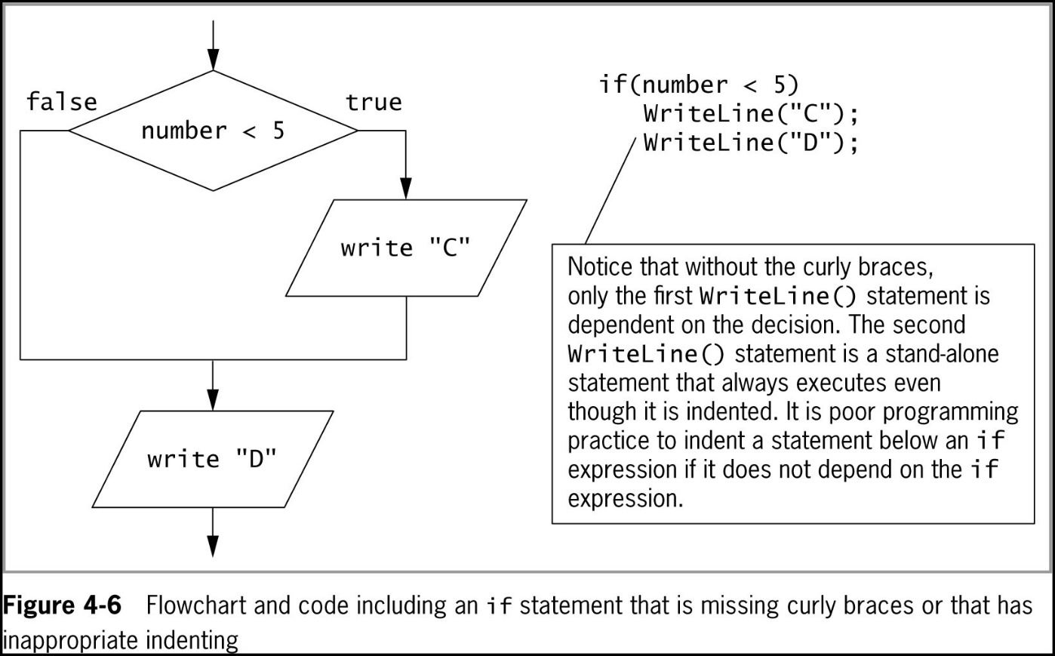
Making Decisions Using the if Statement (5 of 8)
© 2018 Cengage. May not be copied, scanned, or duplicated, in whole or in part, except for use as permitted in a license distributed with a certain product or service or otherwise on a password-protected website for classroom use.

Slide 13
Making Decisions Using the if Statement (6 of 8)
Nested if
One decision structure, or if statement, is contained within another
Decision structures can be nested to multiple levels
If an outer level if statement fails or returns a false result, all inner blocks of code are ignored
© 2018 Cengage. May not be copied, scanned, or duplicated, in whole or in part, except for use as permitted in a license distributed with a certain product or service or otherwise on a password-protected website for classroom use.

Slide 14
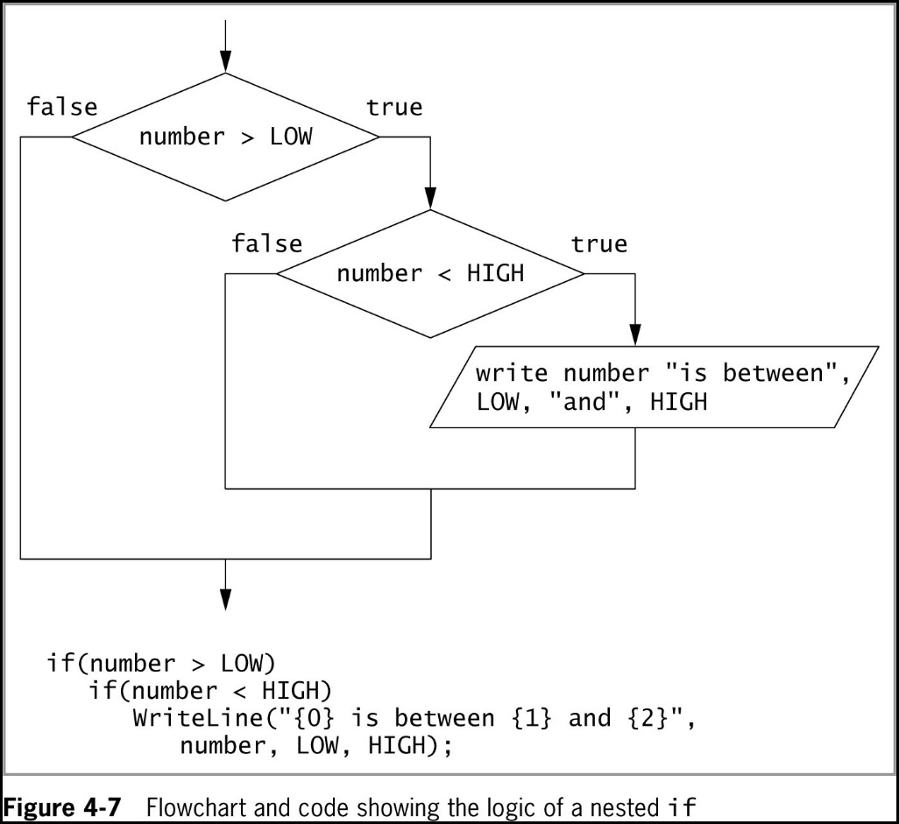
Making Decisions Using the if Statement (7 of 8)
© 2018 Cengage. May not be copied, scanned, or duplicated, in whole or in part, except for use as permitted in a license distributed with a certain product or service or otherwise on a password-protected website for classroom use.

Slide 15
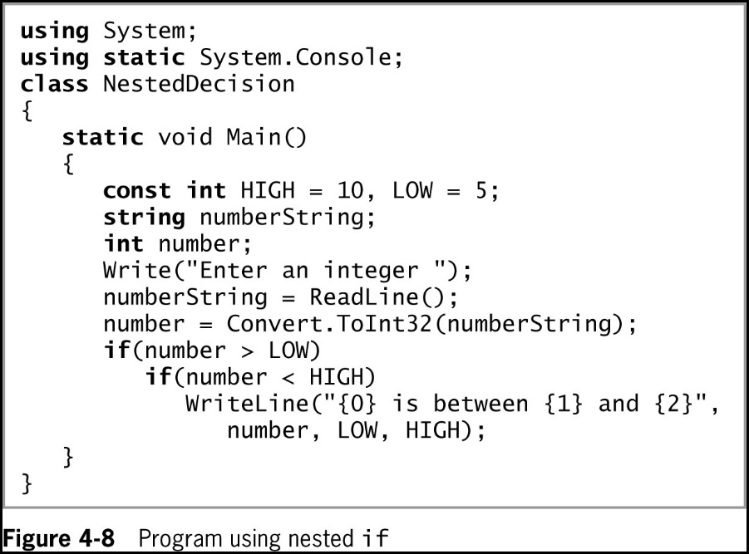
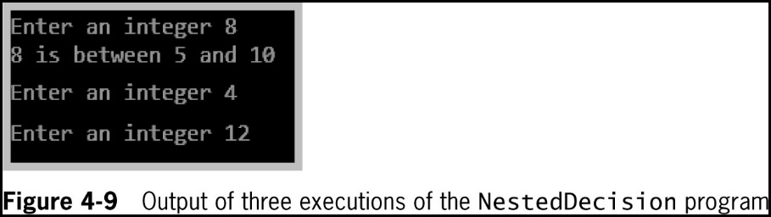
Making Decisions Using the if Statement (8 of 8)
© 2018 Cengage. May not be copied, scanned, or duplicated, in whole or in part, except for use as permitted in a license distributed with a certain product or service or otherwise on a password-protected website for classroom use.

Slide 16
A Note on Equivalency Comparisons
Single equal sign is used to Assign a value to a variable
Number = High
Does NOT compare Number to High
It tries to assign the value of High to Number
if(number = HIGH)
Illegal assignment … Generates an error
Double Equal Sign is used to test for equality
Correct: if(doesEmployeeHaveDependents == numDependents > 0)...
Incorrect: if(doesEmployeeHaveDependents = numDependents > 0)...
© 2018 Cengage. May not be copied, scanned, or duplicated, in whole or in part, except for use as permitted in a license distributed with a certain product or service or otherwise on a password-protected website for classroom use.

Slide 17
Making Decisions Using the if-else Statement (1 of 4)
Dual-alternative decisions
Have two possible resulting actions
if-else statement
Used to perform one action when a Boolean expression evaluates as true, and an alternate action when it evaluates as false
Example:
if (isProjectUnderBudget)
bonus = 200;
else
{
bonus = 0;
WriteLine(“Notify contractor”);
}
© 2018 Cengage. May not be copied, scanned, or duplicated, in whole or in part, except for use as permitted in a license distributed with a certain product or service or otherwise on a password-protected website for classroom use.

Slide 18
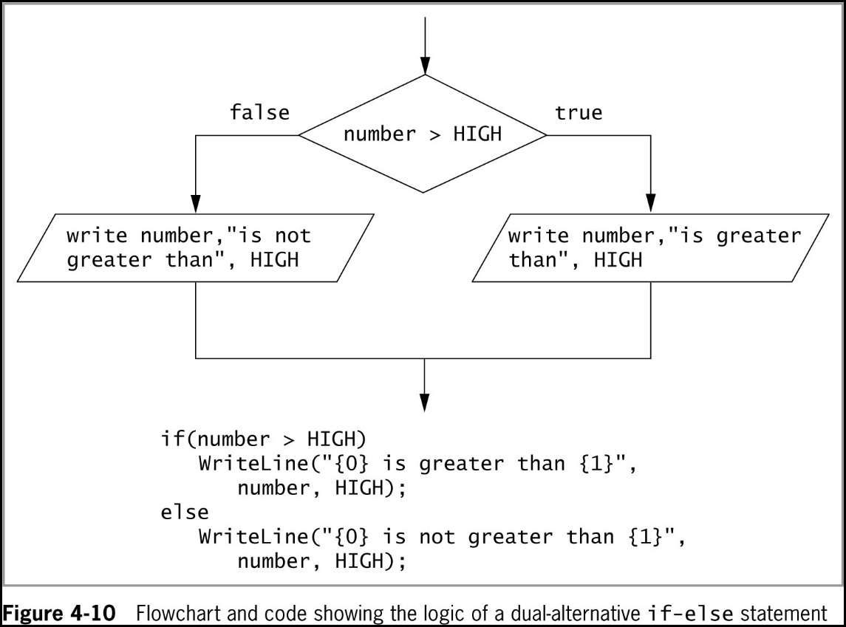
Making Decisions Using the if-else Statement (2 of 4)
© 2018 Cengage. May not be copied, scanned, or duplicated, in whole or in part, except for use as permitted in a license distributed with a certain product or service or otherwise on a password-protected website for classroom use.

Slide 19
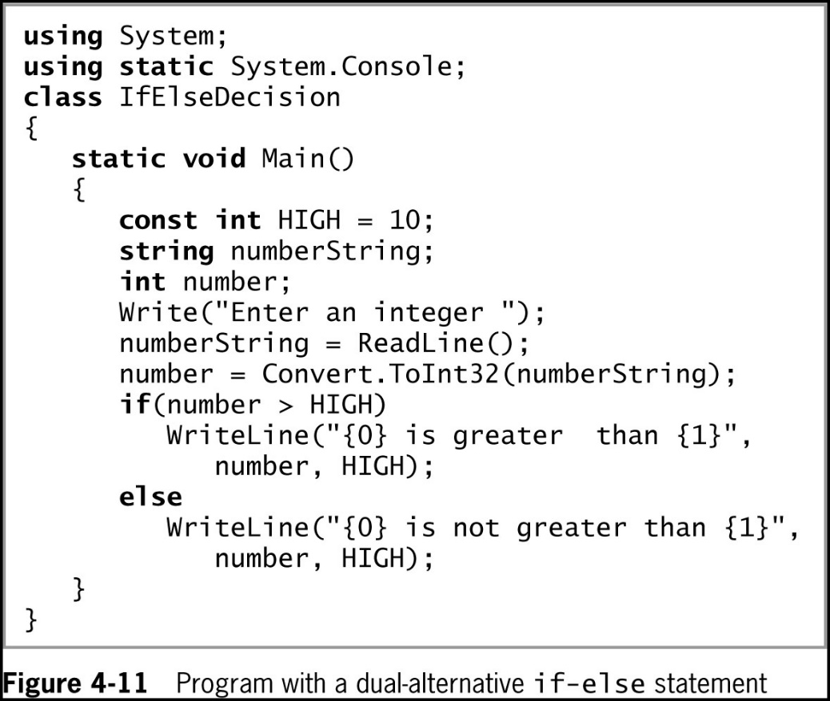
Making Decisions Using the if-else Statement (3 of 4)
© 2018 Cengage. May not be copied, scanned, or duplicated, in whole or in part, except for use as permitted in a license distributed with a certain product or service or otherwise on a password-protected website for classroom use.

Slide 20
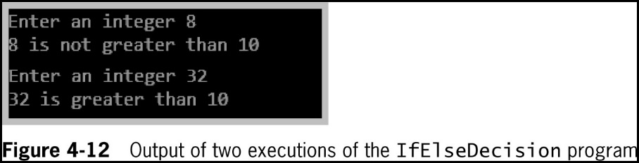
Making Decisions Using the if-else Statement (4 of 4)
© 2018 Cengage. May not be copied, scanned, or duplicated, in whole or in part, except for use as permitted in a license distributed with a certain product or service or otherwise on a password-protected website for classroom use.

Slide 21
Using Compound Expressions in if Statements
You can combine multiple decisions into a single if statement
Use a combination of AND and OR operators
For convenience and clarity:
Combine multiple decisions into a single, compound Boolean expression using a combination of conditional AND and OR operators
© 2018 Cengage. May not be copied, scanned, or duplicated, in whole or in part, except for use as permitted in a license distributed with a certain product or service or otherwise on a password-protected website for classroom use.

Slide 22
Using the Conditional AND Operator (1 of 2)
Conditional AND operator
Determines whether two expressions are both true
Uses two ampersands (&&) and must include a complete Boolean expression on each side of the operator
Truth tables are diagrams used in mathematics and logic to help describe the truth of an entire expression based on the truth of its parts
Short-circuit evaluation
Expressions in each part of an AND expression are evaluated only as much as necessary to determine whether the entire expression is true or false
© 2018 Cengage. May not be copied, scanned, or duplicated, in whole or in part, except for use as permitted in a license distributed with a certain product or service or otherwise on a password-protected website for classroom use.

Slide 23
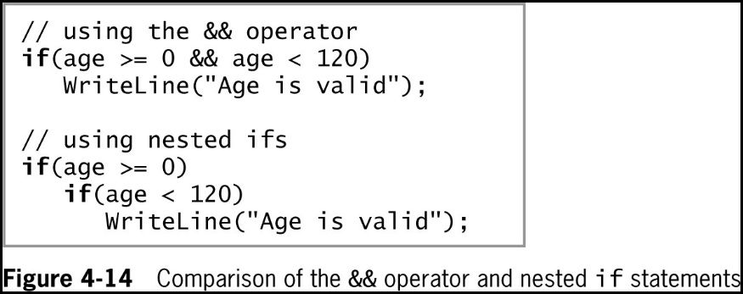
Using the Conditional AND Operator (2 of 2)
© 2018 Cengage. May not be copied, scanned, or duplicated, in whole or in part, except for use as permitted in a license distributed with a certain product or service or otherwise on a password-protected website for classroom use.

Slide 24
Using the Conditional OR Operator (1 of 2)
Conditional OR operator
Used when you want some action to occur even if only one of two conditions is true
Written as two pipes ||
You must include a complete Boolean expression on each side of the operator
Short-circuit evaluation
Expressions in each part of an OR expression are evaluated only as much as necessary to determine whether the entire expression is true or false
© 2018 Cengage. May not be copied, scanned, or duplicated, in whole or in part, except for use as permitted in a license distributed with a certain product or service or otherwise on a password-protected website for classroom use.

Slide 25
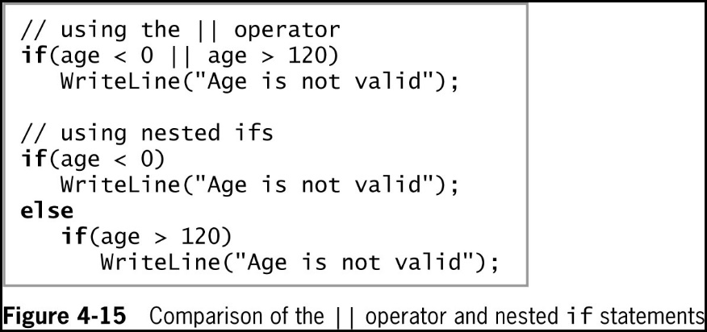
Using the Conditional OR Operator (2 of 2)
© 2018 Cengage. May not be copied, scanned, or duplicated, in whole or in part, except for use as permitted in a license distributed with a certain product or service or otherwise on a password-protected website for classroom use.

Slide 26
Using the Logical AND and OR Operators
Boolean logical AND operator (&) and Boolean logical inclusive OR operator (|)
Work just like their && and || (conditional AND and OR) counterparts
Do not support short-circuit evaluation
Can lead to a side effect (unintended consequence)
Avoid writing expressions that contain side effects
© 2018 Cengage. May not be copied, scanned, or duplicated, in whole or in part, except for use as permitted in a license distributed with a certain product or service or otherwise on a password-protected website for classroom use.

Slide 27
Combining AND and OR Operators (1 of 3)
You can combine as many AND and OR operators in an expression as you need
Example:
When three conditions must be true before performing an action, you can use multiple AND or OR operators in the same expression
When you use a series of only && or only || operators in an expression
They are evaluated from left to right as far as is necessary to determine the value of the entire expression
However, when you combine && and || operators within the same Boolean expression, they are not necessarily evaluated from left to right
Instead, the && operators take precedence
© 2018 Cengage. May not be copied, scanned, or duplicated, in whole or in part, except for use as permitted in a license distributed with a certain product or service or otherwise on a password-protected website for classroom use.

Slide 28
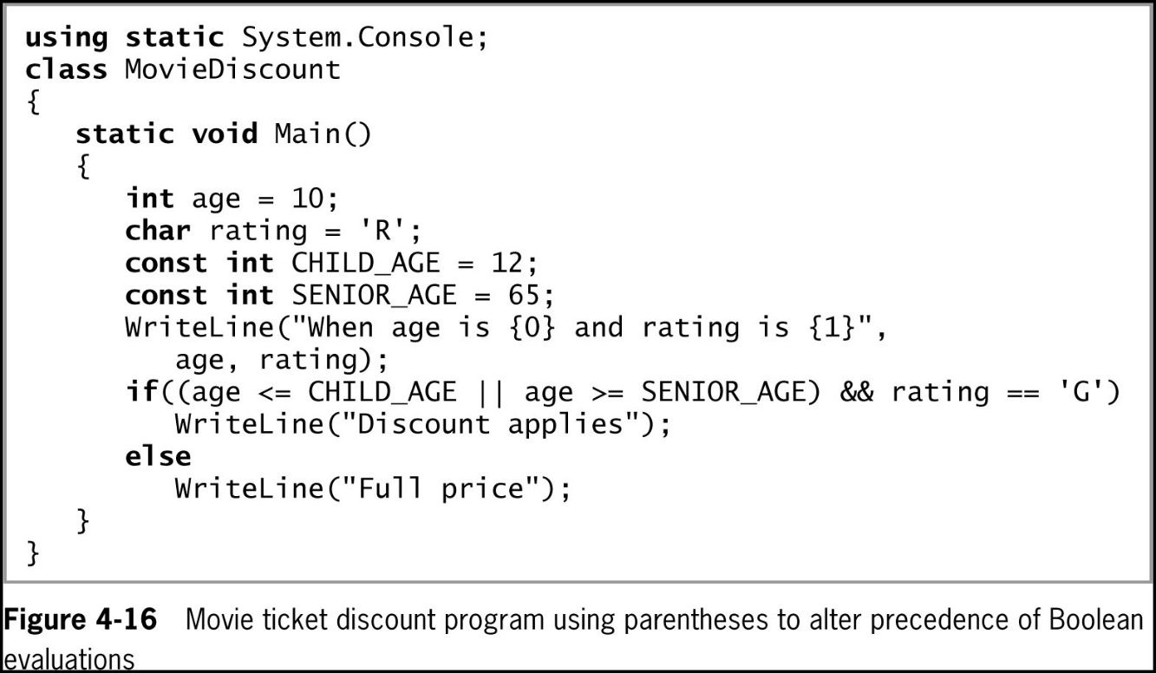
Combining AND and OR Operators (2 of 3)
© 2018 Cengage. May not be copied, scanned, or duplicated, in whole or in part, except for use as permitted in a license distributed with a certain product or service or otherwise on a password-protected website for classroom use.

Slide 29
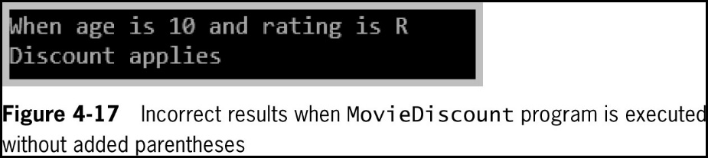
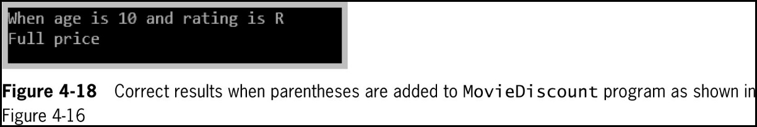
Combining AND and OR Operators (3 of 3)
© 2018 Cengage. May not be copied, scanned, or duplicated, in whole or in part, except for use as permitted in a license distributed with a certain product or service or otherwise on a password-protected website for classroom use.

Slide 30
Making Decisions Using the switch Statement (1 of 5)
switch structure
Tests a single variable against a series of exact matches
Keywords
switch – starts the structure and is followed immediately by a test expression enclosed in parentheses
case – followed by one of the possible values that might equal the switch expression
break – usually terminates a switch structure at the end of each case
Default – optionally is used prior to any action that should occur if the test expression does not match any case
© 2018 Cengage. May not be copied, scanned, or duplicated, in whole or in part, except for use as permitted in a license distributed with a certain product or service or otherwise on a password-protected website for classroom use.

Slide 31
Making Decisions Using the switch Statement (2 of 5)
Governing types
Prior to C# 7.0 there were restrictions on the governing type in a switch statement
But with the newest version, the governing type can be any data type
A switch does not need a default case
Good programming practice to include one
“No fall through rule”
Not allowing code to reach the end of a case
Not allowed in C#
Use a break statement at the end of each case
© 2018 Cengage. May not be copied, scanned, or duplicated, in whole or in part, except for use as permitted in a license distributed with a certain product or service or otherwise on a password-protected website for classroom use.

Slide 32
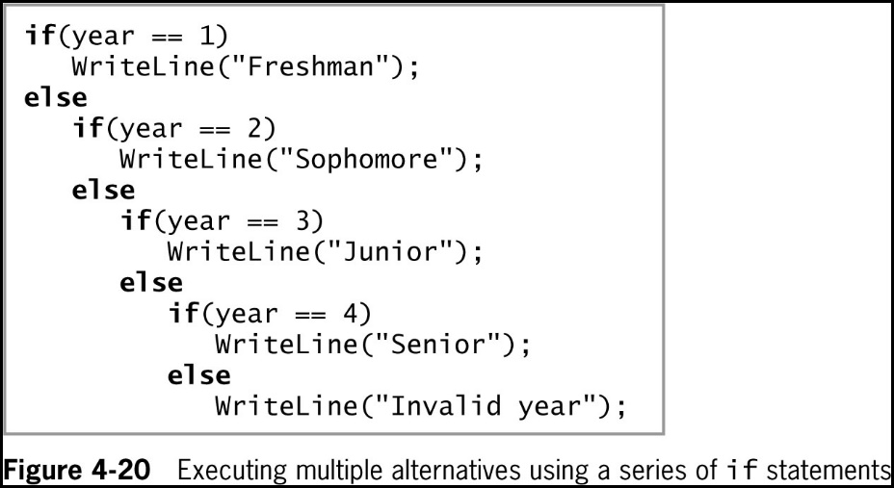
Making Decisions Using the switch Statement (3 of 5)
© 2018 Cengage. May not be copied, scanned, or duplicated, in whole or in part, except for use as permitted in a license distributed with a certain product or service or otherwise on a password-protected website for classroom use.

Slide 33
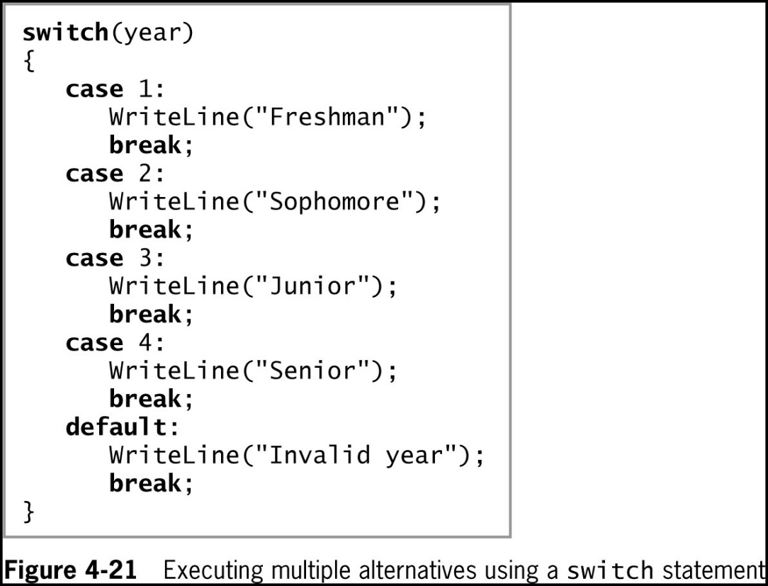
Making Decisions Using the switch Statement (4 of 5)
© 2018 Cengage. May not be copied, scanned, or duplicated, in whole or in part, except for use as permitted in a license distributed with a certain product or service or otherwise on a password-protected website for classroom use.

Slide 34
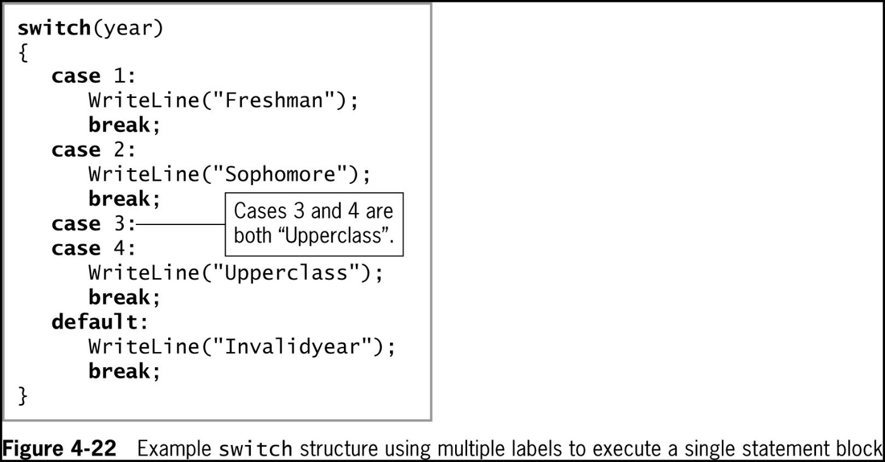
Making Decisions Using the switch Statement (5 of 5)
© 2018 Cengage. May not be copied, scanned, or duplicated, in whole or in part, except for use as permitted in a license distributed with a certain product or service or otherwise on a password-protected website for classroom use.

Slide 35
Using an Enumeration with a switch Statement (1 of 2)
Using an enumeration with a switch structure is often convenient
Recall that an enumeration allows you to apply values to a list of constraints
© 2018 Cengage. May not be copied, scanned, or duplicated, in whole or in part, except for use as permitted in a license distributed with a certain product or service or otherwise on a password-protected website for classroom use.

Slide 36
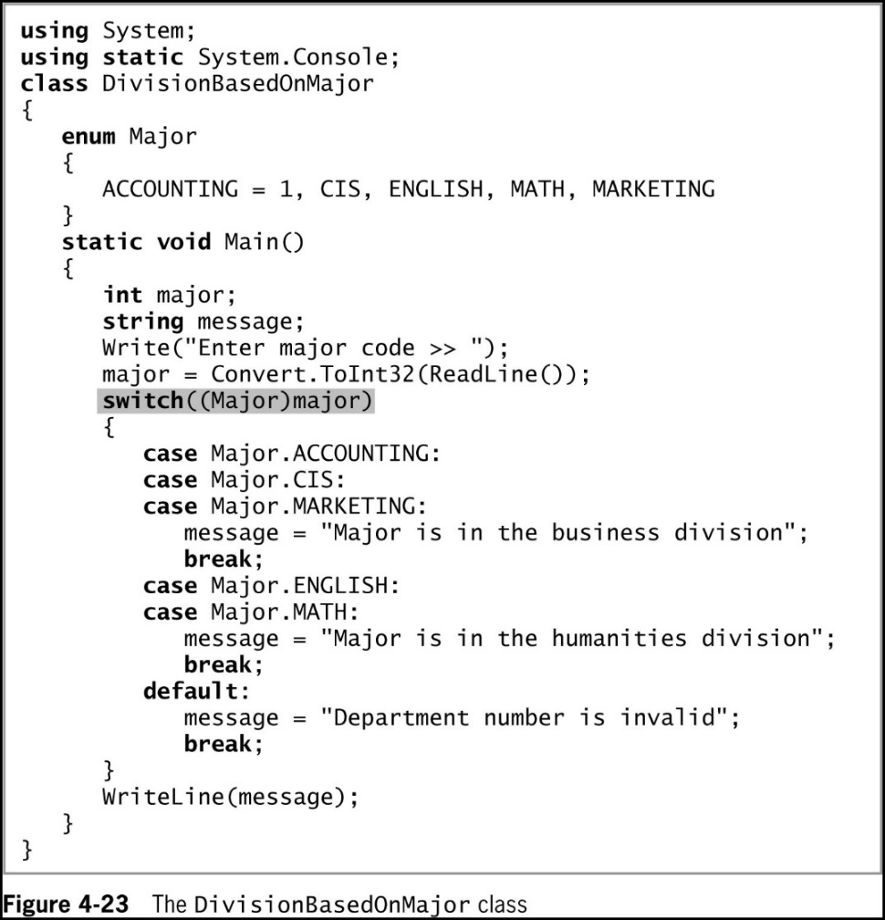
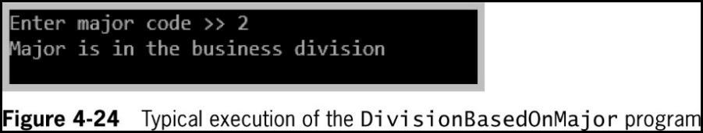
Using an Enumeration with a switch Statement (2 of 2)
© 2018 Cengage. May not be copied, scanned, or duplicated, in whole or in part, except for use as permitted in a license distributed with a certain product or service or otherwise on a password-protected website for classroom use.

Slide 37
Using the Conditional Operator
Conditional operator
Used as an abbreviated version of the if-else statement
A ternary operator that takes three parameters
Syntax
testExpression ? trueResult : falseResult;
Example
WriteLine((testScore >= 60) ? "Pass" : " Fail");
© 2018 Cengage. May not be copied, scanned, or duplicated, in whole or in part, except for use as permitted in a license distributed with a certain product or service or otherwise on a password-protected website for classroom use.

Slide 38
Using the NOT Operator
NOT operator
Written as an exclamation point (!)
Negates the result of any Boolean expression
If the Boolean expression is true, ! makes it false
If the Boolean expression is false, ! makes it true
Logic using the ! operator can be difficult to read and analyze
The ! operator has a higher precedence than && and ||
© 2018 Cengage. May not be copied, scanned, or duplicated, in whole or in part, except for use as permitted in a license distributed with a certain product or service or otherwise on a password-protected website for classroom use.

Slide 39
Avoiding Common Errors When Making Decisions
Most frequent errors include:
Using the assignment operator (=) instead of the comparison operator (==)
Inserting a semicolon after the Boolean expression in an if statement
Failing to block a set of statements with curly braces
Failing to include a complete Boolean expression on each side of an && or || operator
© 2018 Cengage. May not be copied, scanned, or duplicated, in whole or in part, except for use as permitted in a license distributed with a certain product or service or otherwise on a password-protected website for classroom use.

Slide 40
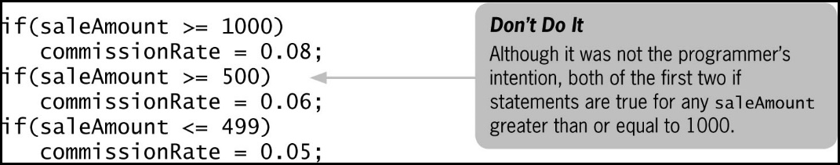
Performing Accurate and Efficient Range Checks (1 of 2)
Range check
A series of if statements that determine whether a value falls within a specified range
Problem
© 2018 Cengage. May not be copied, scanned, or duplicated, in whole or in part, except for use as permitted in a license distributed with a certain product or service or otherwise on a password-protected website for classroom use.

Slide 41
Performing Accurate and Efficient Range Checks (2 of 2)
Solution
If (saleAmount >= 1000)
commissionRate = 0.08;
else if (saleAmount >= 500)
commissionRate = 0.06;
else commissionRate = 0.05;
© 2018 Cengage. May not be copied, scanned, or duplicated, in whole or in part, except for use as permitted in a license distributed with a certain product or service or otherwise on a password-protected website for classroom use.

Slide 42
Using && and || Appropriately
Problem
Print an error message when an employee’s hourly pay rate is less than $5.65 and when an employee’s hourly pay rate is greater than $60
Solution
if (payRate < 5.65 || payRate > 60)
WriteLine ("Error in pay rate");
© 2018 Cengage. May not be copied, scanned, or duplicated, in whole or in part, except for use as permitted in a license distributed with a certain product or service or otherwise on a password-protected website for classroom use.

Slide 43
Using the ! Operator Correctly
Problem
Make sure that if the sales code is not ‘A’ or ‘B’, the customer gets a 10% discount
Solutions
if (salesCode != 'A' && salesCode != 'B')
discount = 0.10;
if (!(salesCode == 'A' || salesCode == 'B'))
discount = 0.10;
© 2018 Cengage. May not be copied, scanned, or duplicated, in whole or in part, except for use as permitted in a license distributed with a certain product or service or otherwise on a password-protected website for classroom use.

Slide 44
Decision-Making Issues in GUI Programs (1 of 3)
Making a decision within a method in a GUI application is no different from making one in a console application
You can use if, if…else, and switch statements in the same ways
GUI programs use controls to make decisions
The user clicks on a Button, which causes an event to fire
The user chooses one of several RadioButtons
The user chooses an item from a ListBox
© 2018 Cengage. May not be copied, scanned, or duplicated, in whole or in part, except for use as permitted in a license distributed with a certain product or service or otherwise on a password-protected website for classroom use.

Slide 45
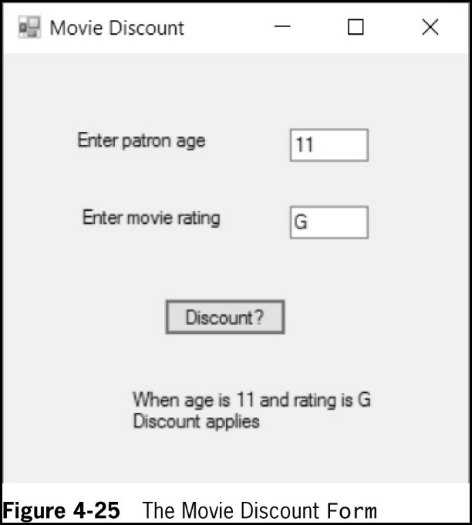
Decision-Making Issues in GUI Programs (2 of 3)
© 2018 Cengage. May not be copied, scanned, or duplicated, in whole or in part, except for use as permitted in a license distributed with a certain product or service or otherwise on a password-protected website for classroom use.

Slide 46
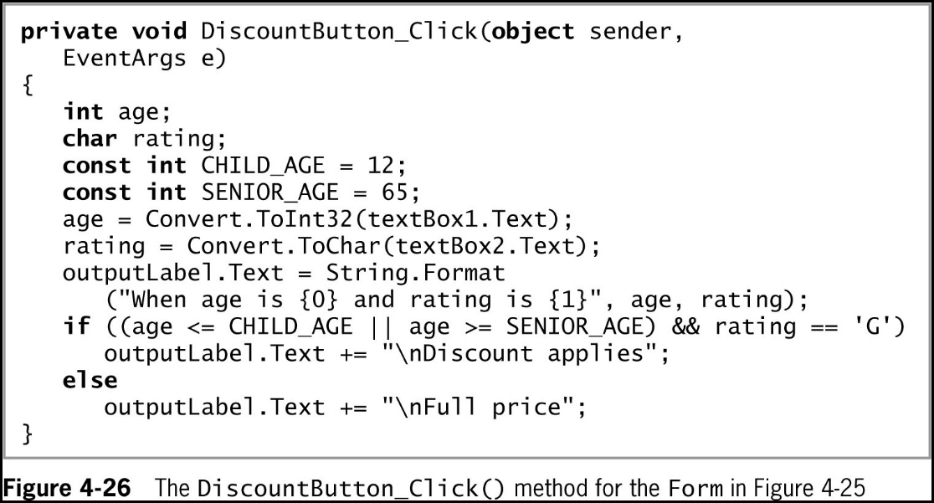
Decision-Making Issues in GUI Programs (3 of 3)
© 2018 Cengage. May not be copied, scanned, or duplicated, in whole or in part, except for use as permitted in a license distributed with a certain product or service or otherwise on a password-protected website for classroom use.

Slide 47
Chapter Summary (1 of 2)
A flowchart is a pictorial tool that helps you understand a program’s logic
The if statement makes a single-alternative decision using the keyword if, followed by parentheses that contain a Boolean expression
When you make a dual-alternative decision, you can use an if-else statement
The conditional AND operator (&&) takes action when two operand Boolean expressions are both true
The conditional OR operator (||) takes action when at least one of two operand Boolean expressions is true
AND operators (&&) take precedence
© 2018 Cengage. May not be copied, scanned, or duplicated, in whole or in part, except for use as permitted in a license distributed with a certain product or service or otherwise on a password-protected website for classroom use.

Slide 48
Chapter Summary (2 of 2)
The switch statement tests a single variable against a series of exact matches
The conditional operator is used as an abbreviated version of the if-else statement
The NOT operator (!) negates the result of any Boolean expression
Errors are common when making decisions
Decisions within GUI methods are just like decisions in console applications
© 2018 Cengage. May not be copied, scanned, or duplicated, in whole or in part, except for use as permitted in a license distributed with a certain product or service or otherwise on a password-protected website for classroom use.

